Slide 1


DRAFT
OF
GROUP PRESENTATION
ALY 6080​ Prof. Atherley Valarie
By
Group 5
Sunil Raj Thota
Sashank Yakkali
Feng Gao

Slide 2
Introduction
Project requirements: To analyze the figures, I used data from the EPA Gov and the CDC websites. Big data analytics allows healthcare organizations to analyze their cost efficiency to use large data sets.
Milestones: The project's start and completion dates; important deliveries require Client authorization; and the project requires Stakeholder approval.
Job assignments: To enrich and expand findings, each student compares his or her conclusions on an assigned subject to those of others working on the same topic from other viewpoints. Each group member is responsible for taking notes on all presentations.
Risks and Strategies: Determine the risks. Recognize possibilities, Determine the effect's likelihood and size. Decide on a response, Each object should have an owner assigned to it. Risks must be disclosed.
Measure of success: The five parameters we want to assess against the business case are time, quality, cost, stakeholder satisfaction, and performance.

Slide 3
Summary
Keva Health Inc is a health-care firm that emphasizes on its real-time monitoring technology, that creates individualized medical services for everyone. Following the advancement of medicine, patients with chronic lung problems continue to have poor results.
It was owing in shortage of precise methods for physicians to identify this problem, as well as inadequate coordination of care. Such therapy roadblocks might be accomplished with the aid of new technologies.
Through integrating advanced remote tool lets with data self-monitoring methods, Keva Health seeks to promote long-term compliance and engagement with self-management techniques.
Individuals experience individualized, performance insights in reaction to their problems and increase power measures, and then they can also submit and read notifications via their clinic or hospital concerning their therapy.

Slide 4
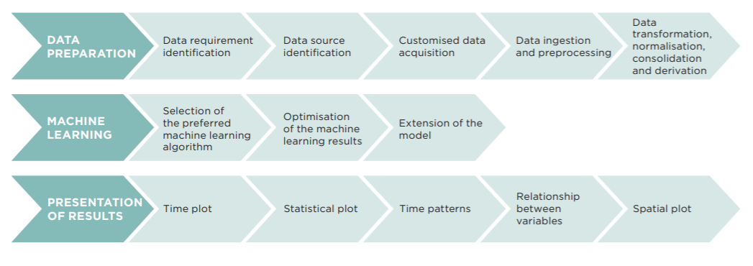
Project Specifications

Slide 5
Roadmap
Exploratory data analysis
Visualization
Impact Assessment
Dataset
Job Description
Types and models
Additional use cases

Slide 6
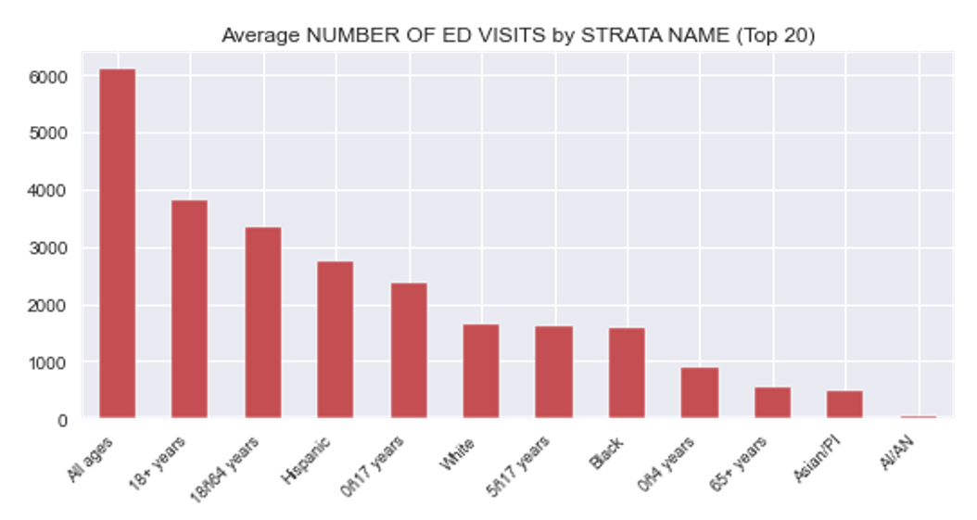
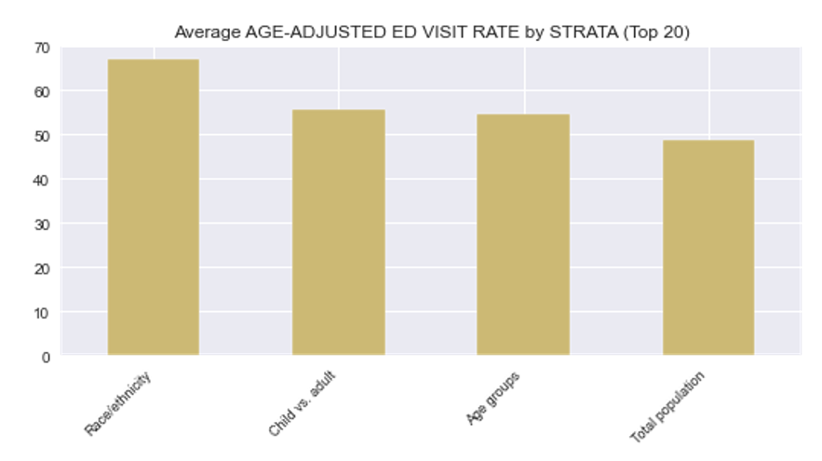
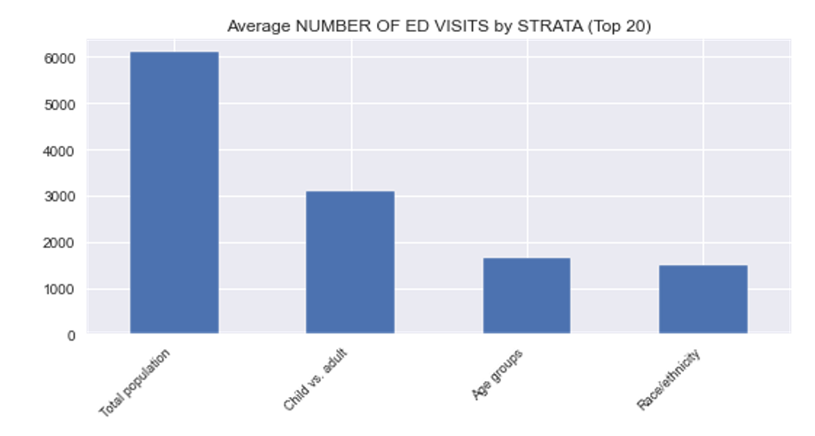
For each continuous variable by each categorial variable, these are the bar graphs.

Slide 7
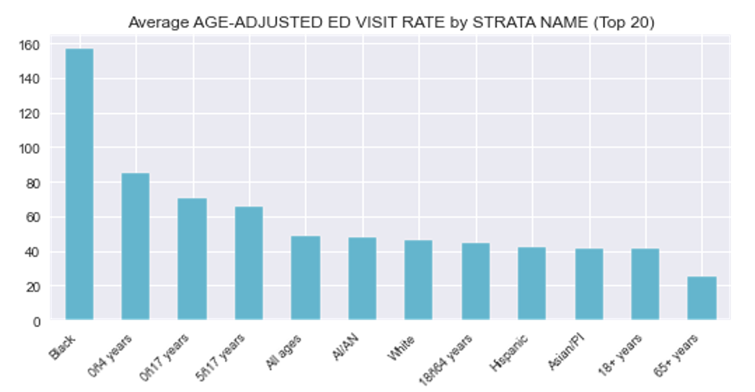
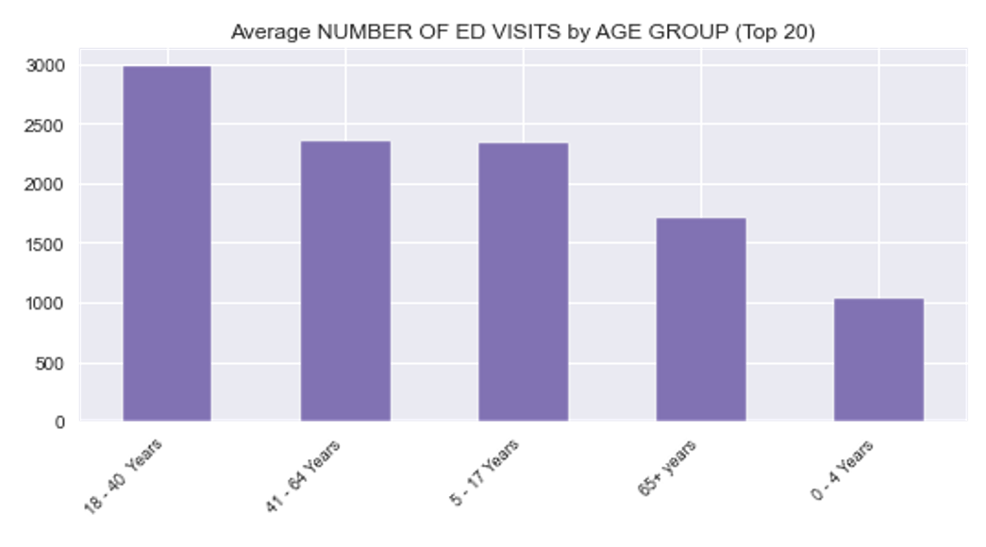
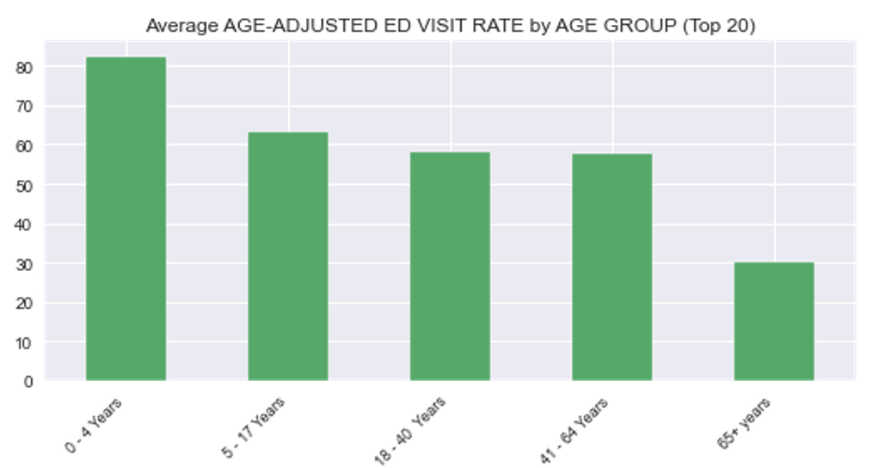
Each continuous variable is represented by a bar plot.

Slide 8
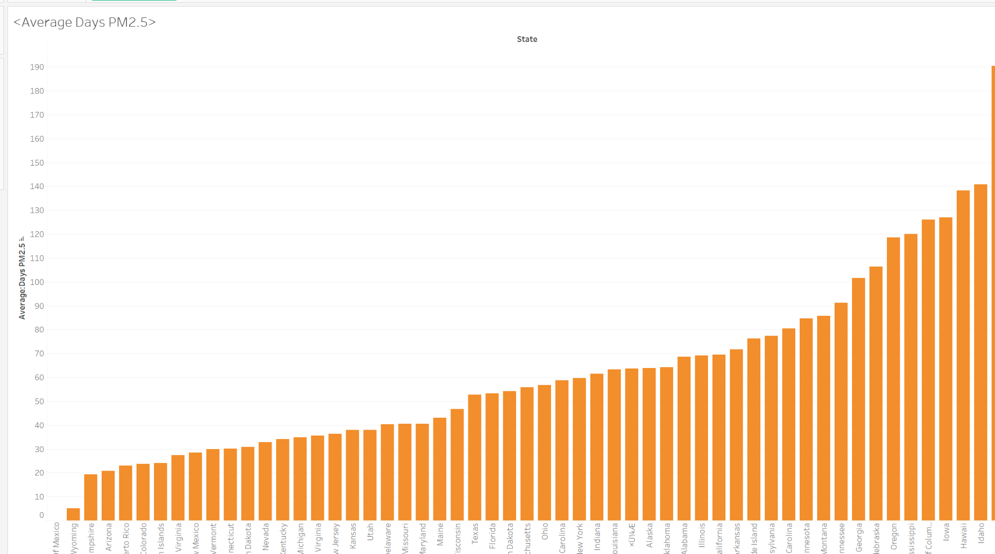
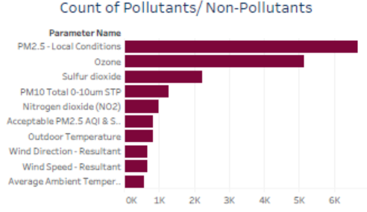
Pollutant's emission rate
PM2.5 days range from fewer to more.
Pollutants/Non-Pollutants Count

Slide 9
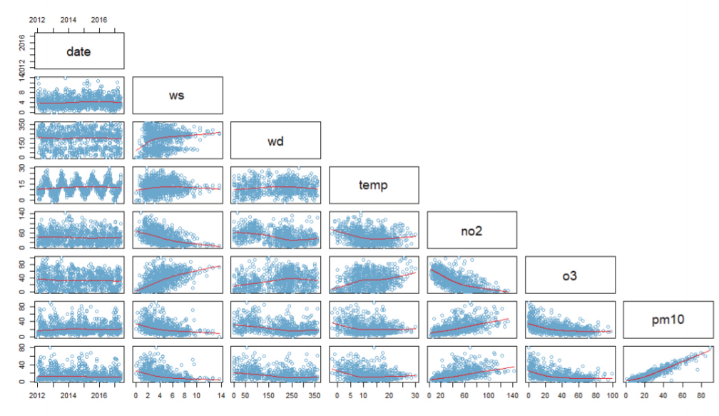
The plotting of different variables is done in pairs.
This section discusses the relationships between wind direction, PM10, temperature, wind speed, NO2, PM2.5, and O3..
Suggests that NO2 concentrations tend to decrease as wind speed rises. The curve shape of temperature-dependent NO2 concentrations is moderate.
As the temperature climbs above 0 degrees Celsius, the concentration drops at first, then rises slightly before stabilizing until the temperature reaches around 10 degrees Celsius.

Slide 10
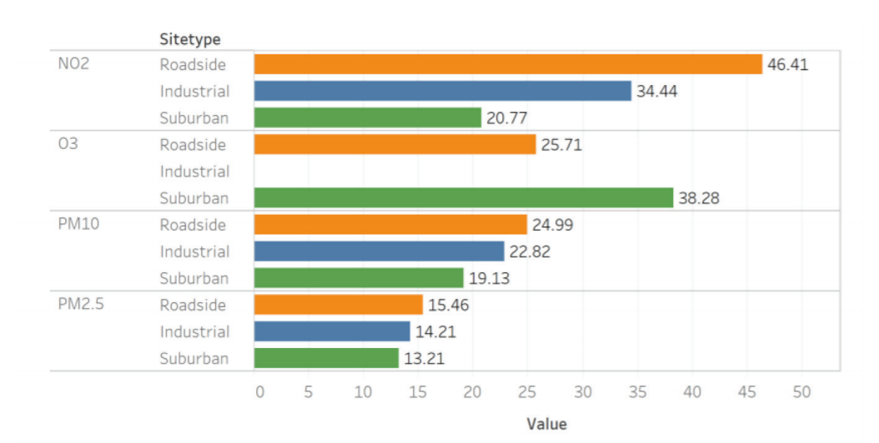
Concentrations of various contaminants on an average basis.
NO2, O3, PM10, and PM2 are common pollutants. 5 emissions from highway locations are rated highest, while those from residential sites are ranked lowest, with something in the between coming from industrial sites.

Slide 11
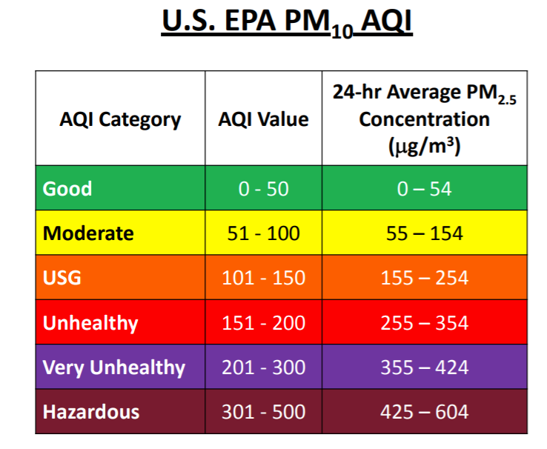
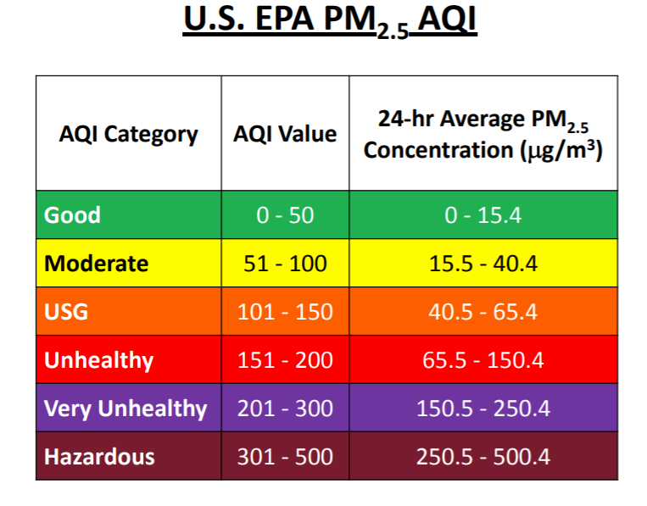
Methodology of delivering the outcome
We were able to evaluate the essential parameters and conduct correlation analysis by dividing the AQI category, AQI value, and 24-hour PM level into good (0-50), moderate (51-100), USG (101-150), unhealthy (151-200), really unhealthy (201-300), and hazardous (301-500).

Slide 12
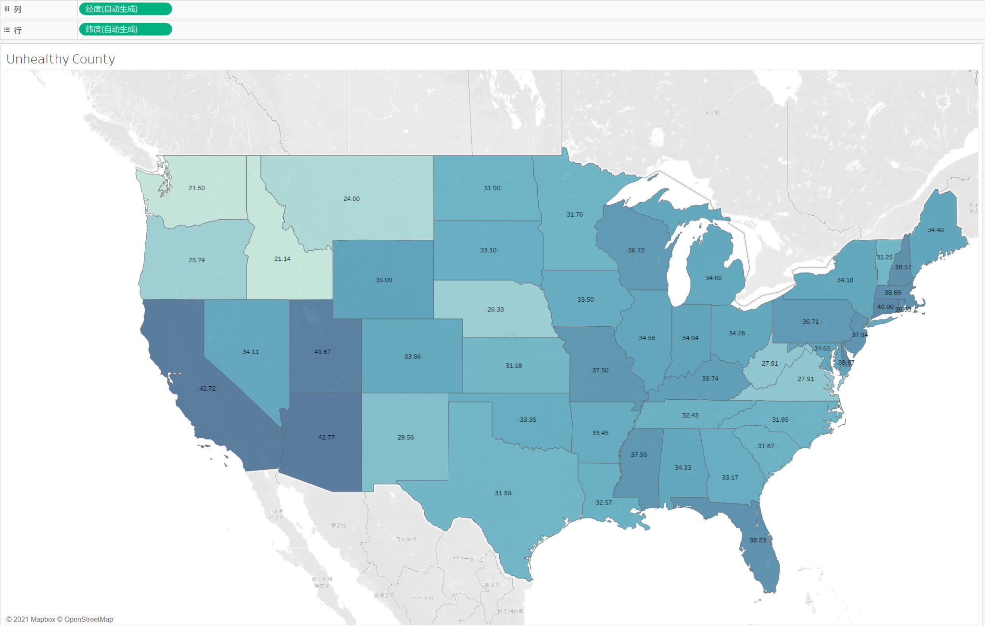
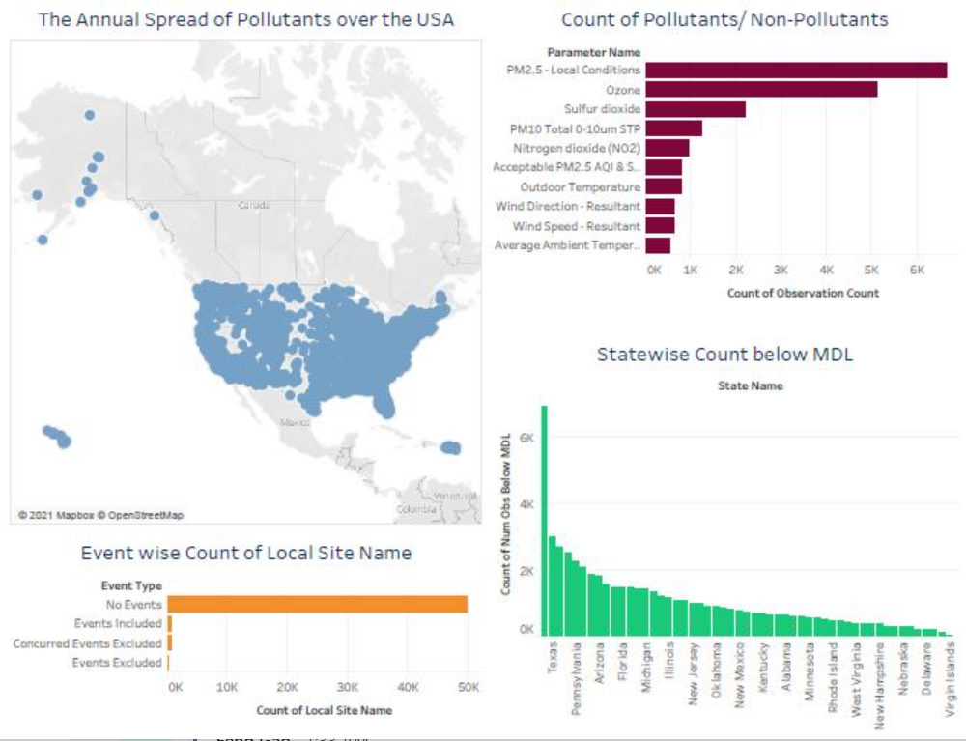
Unhealthy county representation
R was used for the EDA, and Tableau was used to plot the visuals.

Slide 13
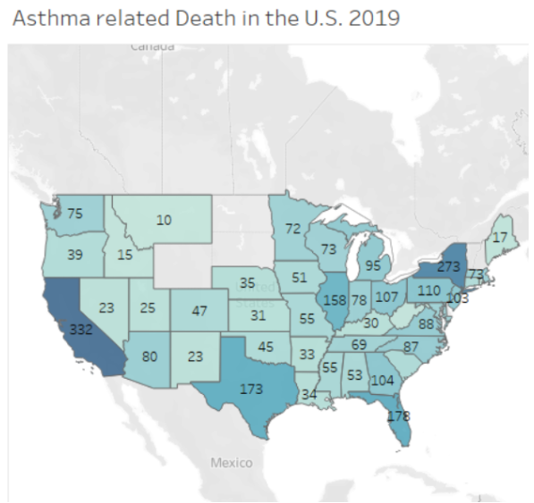
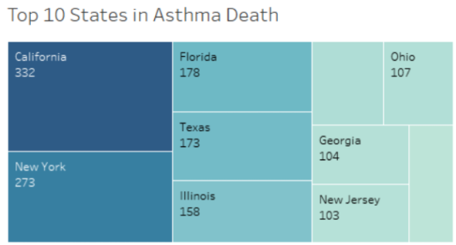
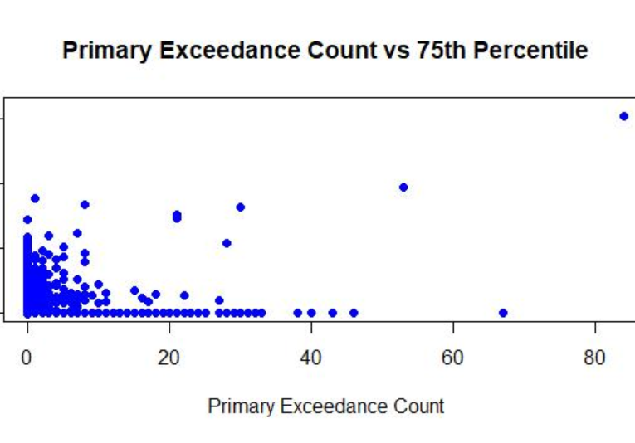
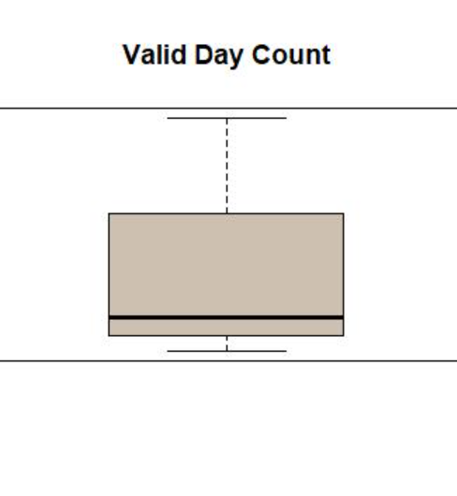
R and Tableau presentations

Slide 14
As we near the end of our overview of Keva health, it becomes clear that the topic has a wide variety of potential applications in various disciplines.
In the preceding chapters, we went through a few essential theoretical and practical ideas to keep in mind while creating a data visualization.
We've also looked at and critiqued several data visualization examples, noting frequent blunders and helpful hints along the way.
Conclusion

Slide 15

Thank you

